Slide 1

HEER + ARTS & HUMANITIES
Our Children, Our Commitment, Our Concern

Slide 2
Health, Education, Employment, Recreation
Arts & Humanities

Slide 3

H
Health
Chair: Continental Mariah Bourgouis
Objectives
To educate our community about health issues that may impact their lives, and to provide guidance on how to prevent or cope with these health issues.

Slide 4
HEALTH AWARENESS
Continental Societies, Inc.® has two (2) major initiatives for health awareness:
Asthma - a serious, life-threatening respiratory disease affecting over 20 million Americans, has risen sharply over the past 30 years, particularly among children ages 5 to 14.
Obesity - Childhood obesity is a complex chronic (long-term) condition that happens when your child is above a healthy weight for their age, height, and sex.
Juvenile Diabetes
Mental Health
And more…

Slide 5
What can we do to help our children with these issues?
Partnerships with local and national organizations to educate our youth and their parents/guardians.
How can we accomplish this?
Colgate Van for Dental
PSA in Schools, Radio Stations, social media
Red Ribbon (all schools)
Carter’s Closet (Walter P. Carter initiated by Cont. Constance Robinson to collect uniforms.
And more

Slide 6

E
Education
Chairs: Continental Shalanda Lyons-Oke & Continental Delalna Penn
Objectives
To help our children enhance their ability to identify, understand, interpret, create, communicate, compute, and use printed and written materials associated with varying contexts.

Slide 7
How do we accomplish this?
Book Buddies
(Continentals- Dolores Winston, Maria Hopewell, & Ann Taylor Ross at Empowerment)
Book fair
Little Library (Work with Walter P. Carter)
National initiative African American Read In (All Schools)
Pen Pal Project with South Africa (Continental Delores Winston)

Slide 8
How do we accomplish this?
Book Buddies (Continentals- Dolores Winston, Maria Hopewell, & Ann Taylor Ross at Empowerment)
Book fair
Little Library (Walter P. Carter )
National initiative African American Read In (All Schools)
Pen Pal Project with South Africa (Continental Delores Winston)
Reading challenge
April is Poetry Month – have a Poetry Reading contest
Back to School Night
First Day of School visits
Scholarships ( fundraisers)
And more.

Slide 9

E
Employment
Chair: Continental Ann Taylor Ross
Objective(s)
The Continentals provide support for students in exploring and preparing for careers.

Slide 10
How do we accomplish this?
Career Day at Arbutus (Continental Lynetta Parker –Lead)
Forest Park High School Career Project (Continental Ann T. Ross)
Preparing for an interview
Teen job fair
Resume writing
College Application and FASFA Seminar
And more.

Slide 11

R
Recreation
Chair: Continental Alexis Seth
Objective(s)
The Continentals provide support and opportunities for students to enjoy recreational activities.

Slide 12
How do we accomplish this?
Basketball Academy (Continental Stephanie Lee)
Host activities i.e., Hula Hoop activities, Double Dutch Jump rope event
Dance event
And more.

Slide 13

ARTS & HUMANITIES
Chair: Continental Lorna Byers
Objective
The Continentals will provide opportunities for students to become engaged in the creative world of art and culture.

Slide 14
How do we accomplish this?
Invite students to see the Nutcracker Performance (Continental Lorna Byer)
Invite students to local museums (Reginald Lewis Museum, Great Black Wax Museum, Industrial)
Sponsor talent shows
Invite students Plays and Orchestras
And more

Slide 15
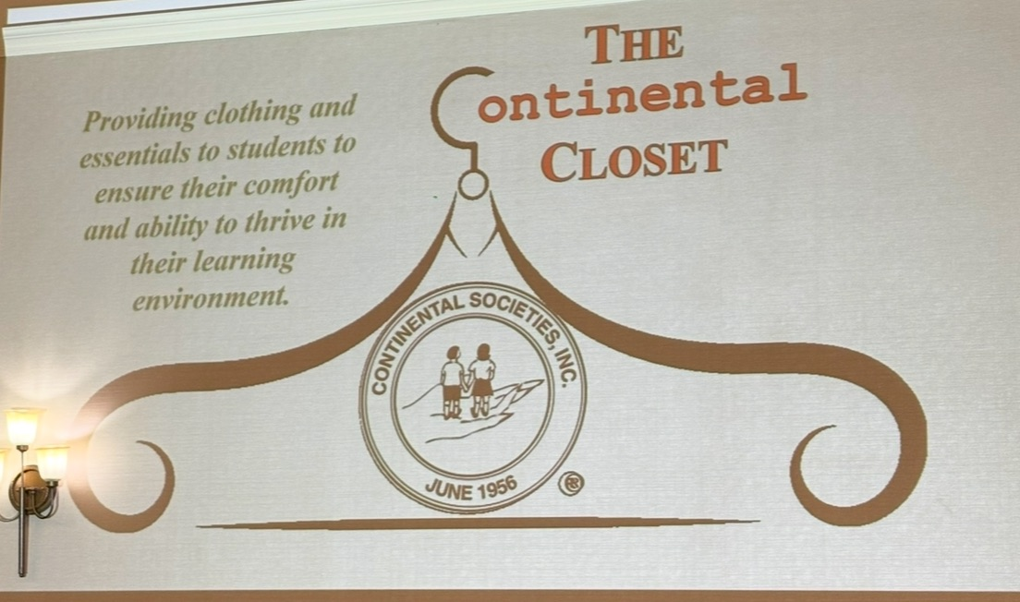
Our Newest National Program
The Continental Closet provides clothing and essentials to students to ensure their comfort and ability to thrive in their learning environment.

Slide 16
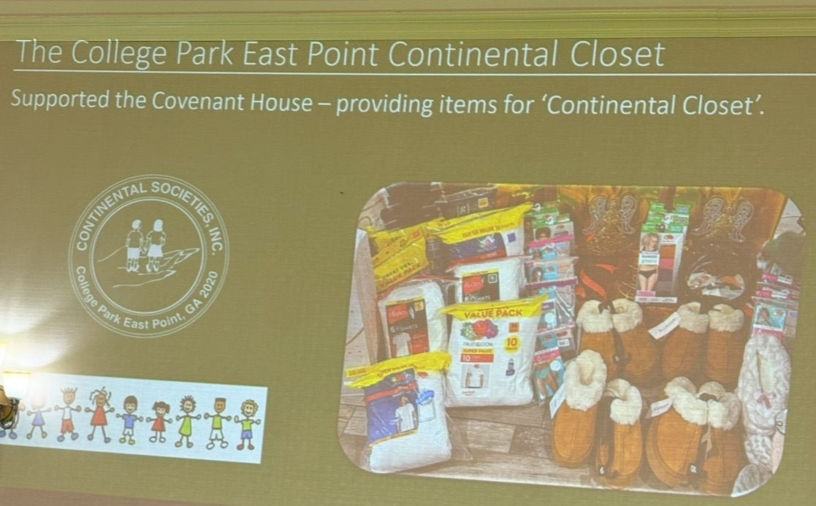
The College Park East Point Continental Closet

Slide 17
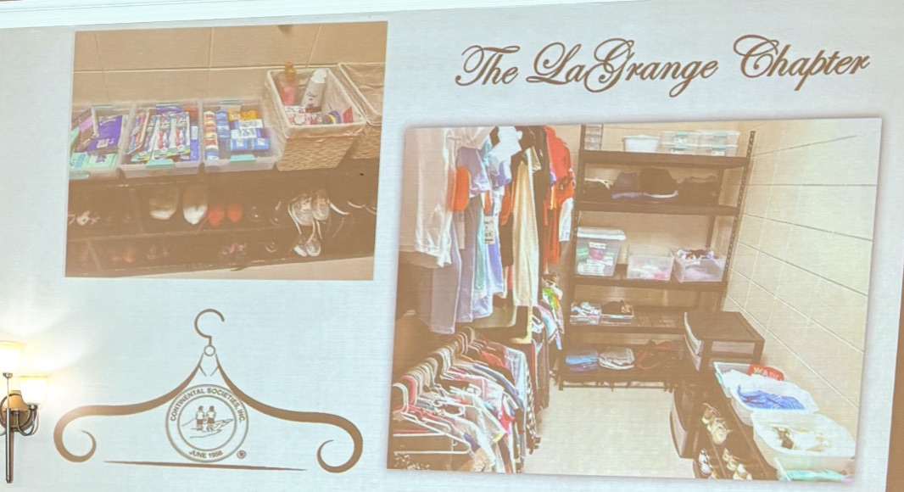
The LaGrange Chapter

Slide 18
Continental Closet
How do we accomplish this?
There may be one at Booker T. Washington Middle School. We can form a partnership with the school and stock the closet with gently used and new items. (Continental Stephanie Lee)

Slide 19


Slide 20

Breakout Sessions
New ideas for your committee
Proposed dates for activities
Discuss an annual proposed budget for the committee
Committee Meeting Dates
** Remember each member is required to join one (1) HEER + Arts and Humanities Committee

